Slide 1

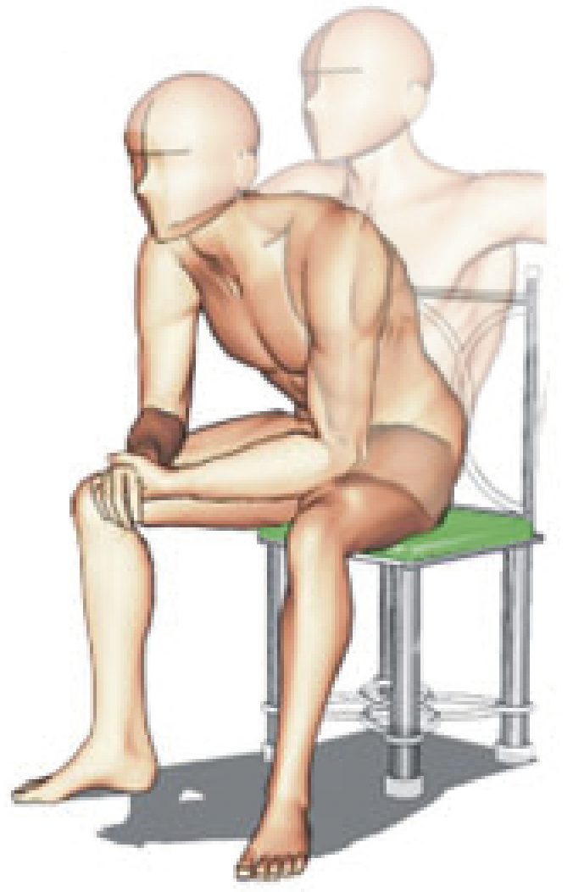
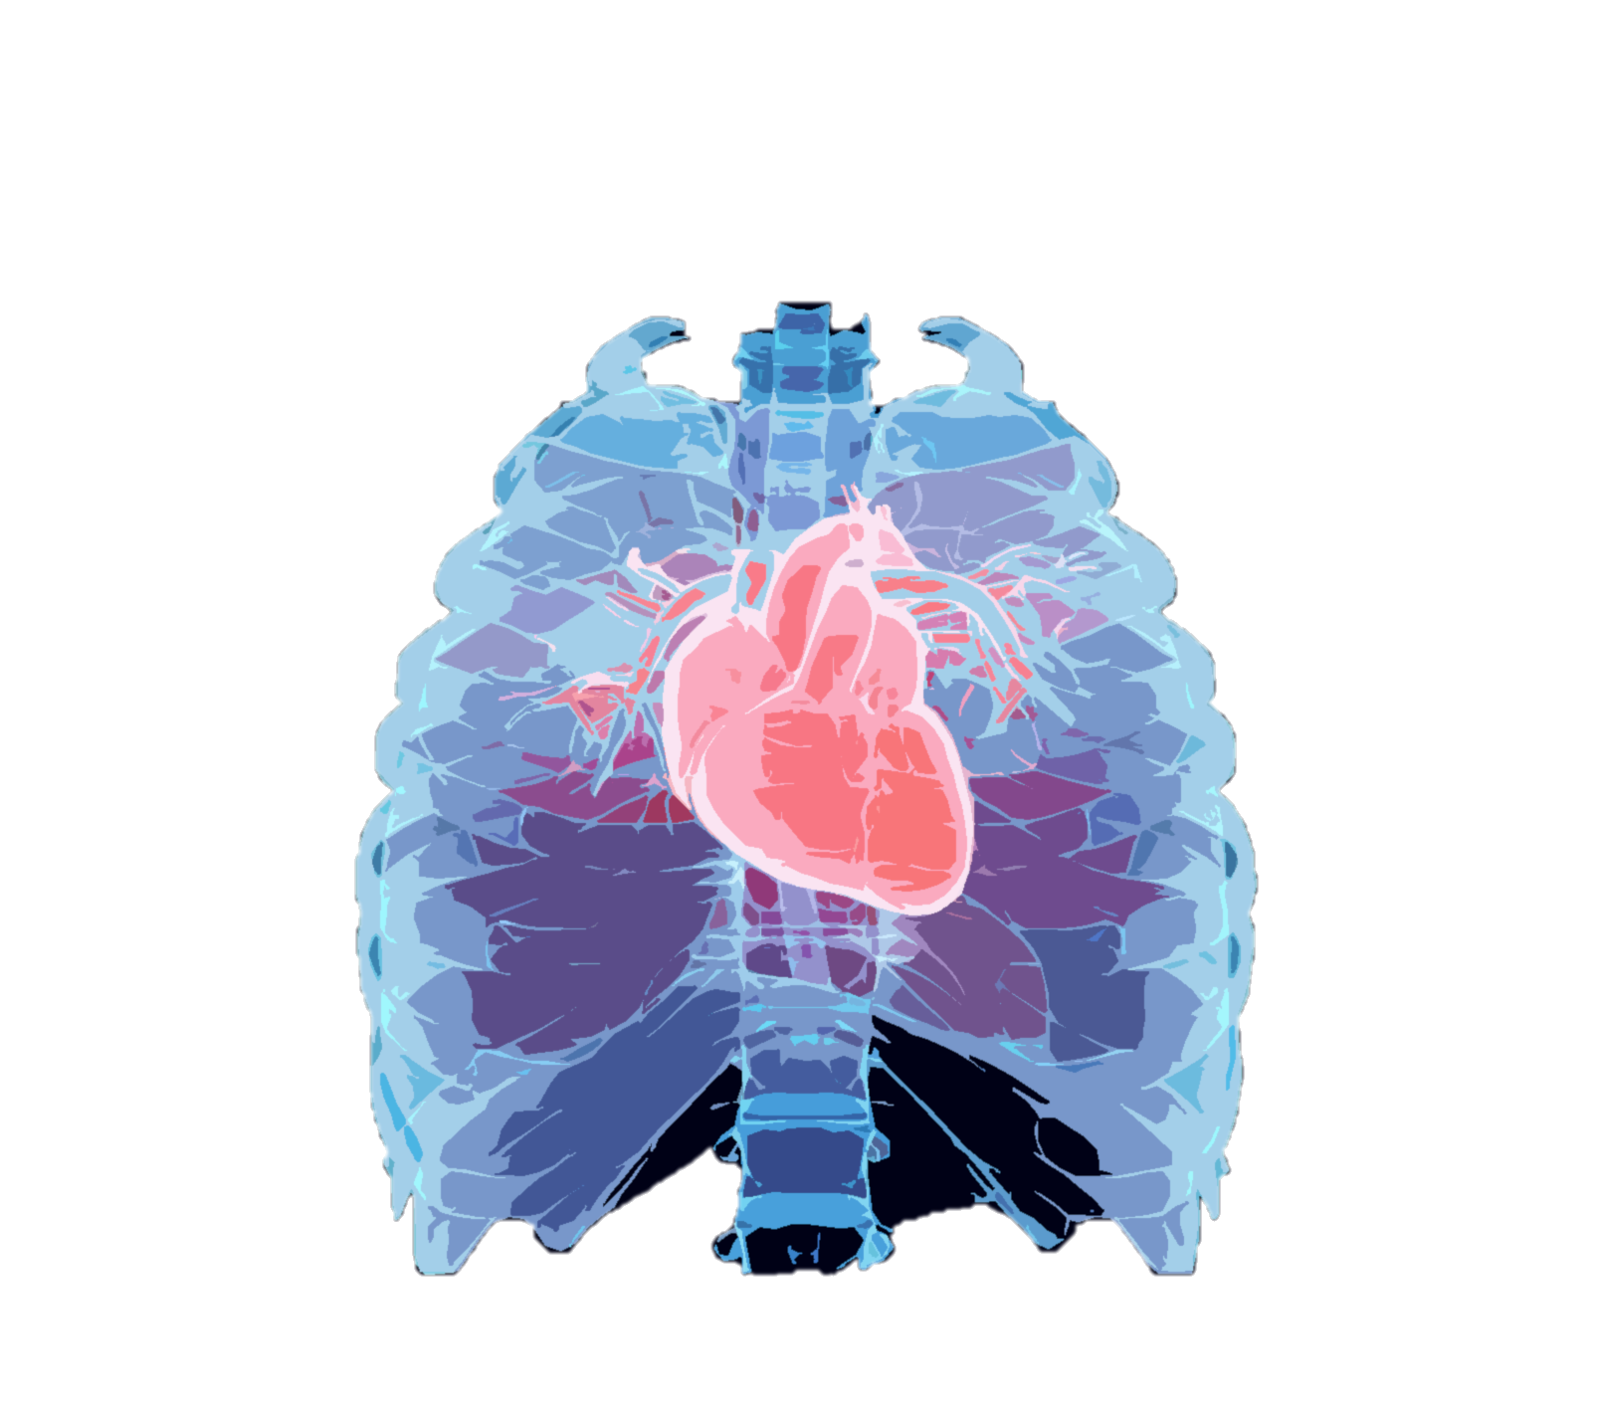
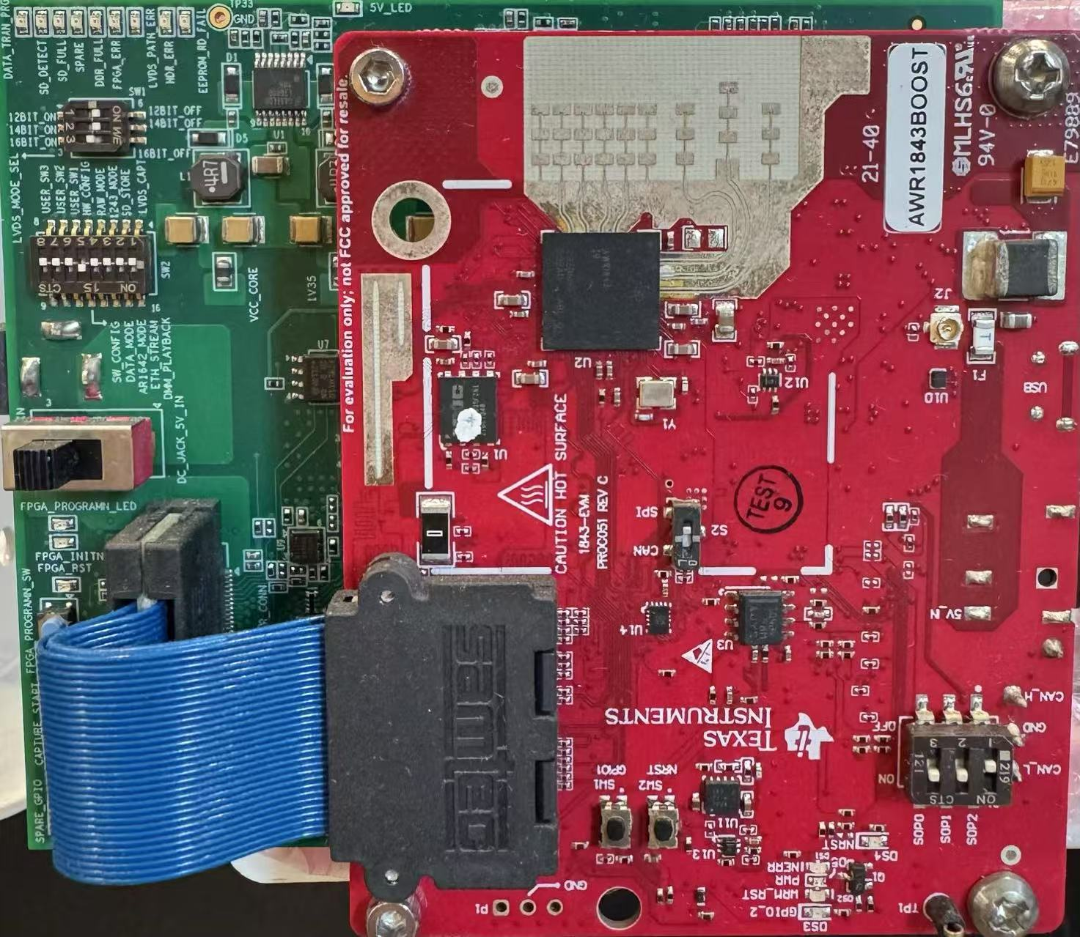
(b) Cardio-Focusing and -Tracking (CFT) Algorithm
ECG Monitor
Low-SNR Signals
0.4m
Derivative-Free
Optimization
0.2m
0.4m
TI-AWR 1843
77-81GHz with Tx2Rx4
Subject with Random Body Position
Search Space
Search for Cardio-Focused (CF) point
High-SNR Signals
Format Radar Signal to
the Data Matrix
Provide Initial State
for CFT
Convert to Spectrogram
(a) Rough Localization
(c) Transfer Learning
Chirps (Fast Time)
FFT
Backbone
1D CNN
1D CNN
Ch. 8
ECG Outputs
…
Deep learning Model
Ch. 2
Virtual Antenna Channels (AoA)
Ch. 1
Spectrograms
Frames (Slow Time)
Object Detection
Notes:
Already graduated and will get the degree in November

